Slide 1
Foundation update

Slide 2
Contents
Board update
Funded projects
Funding summary

Slide 3
Board update
Jun Murai from Japan confirmed as the sixth Board member. Search continuing for seventh and final Board member.
Australia: Michael Malone
China: Edward Tian
India: Sharad Sanghi
Indonesia: Sylvia Efie Sumarlin (Chair)
Pakistan: Danish Lakhani
Notes:
From the last round, Jerry Yang did not accept

Slide 4
Project update (1)
Project: PNG training (2018-19-20)
Donors: Asia Foundation (USA); DFAT (Australia); MFAT (New Zealand)
Economy: Papua New Guinea
Funding: USD 343,323. USD 108,408 in additional funding from Australia in 2019
Impact
18 community engagements so far including workshops, technical assistance and consultations (since August 2018)
Notes:
The final amount coming directly to the APNIC Foundation is USD 343,323 – this is a revised amount, but there is no change to the overall project amount invested in PNG, .
The USD 214,677 to the Asia Foundation is used to fund cyber security activities and support APNIC participation
The project will continue in 2019, with more training workshops
Additional funding is likely to be offered

Slide 5
Project update (2)
Project: PNGCERT support (2018-19)
Donor: DFAT (Australia)
Economy: Papua New Guinea
Funding: USD 56,506
Impact
Provision of equipment to PNGCERT

Slide 6
Project update (3)
Project: Pacific technical training (2019-20)
Donor: DFAT
Economies: Fiji, Solomons, Tonga and Vanuatu
Funding: USD 336,000
Impact
Technical training and assistance in the Pacific

Slide 7
Project update (4)
Project: Myanmar university network training (2019)
Donor: KDDI Foundation (Japan)
Economy: Myanmar
Funding: USD 29,144
Full cost recovery for APNIC for two workshops and two trainers

Slide 8
Project/Program update (5)
ISIF Asia 2019 Network Operations Research Grants
Modelling and identifying IP address space fragmentation pressure points. Curtin University. Australia. USD 20,000
Honeynet Threat Sharing Platform. SGU, BSSN (Badan Siber & Sandi Negara) and Indonesia Honeynet Project (IHP). Indonesia. USD 20,000
Implementation and Utilities of RDAP for wider usability among Internet Stakeholders. University of Malaya. Malaysia. USD 20,000
Network coding over satellite links: scheduling redundancy for better goodput. The University of Auckland. New Zealand. USD 20,000

Slide 9
Project/Program update (6)
ISIF Asia 2019 I4D Powering Internet Infrastructure Grants
Telemetering the telltale signs of power issues of wireless internet relays. Rural Broadband – AirJaldi. India. USD 20,000
Network Remote Powering through Quasi-Passive Optical Nodes. Royal Melbourne Institute of Technology. Australia. USD 20,000

Slide 10
ISIF Asia
11th year of operation
USD 120,000 allocated via six grants to give economies
The 2019 I4D Award was not granted this year, instead one additional grant under the Network Operations Research was allocated.
Thanks to the EC for your continuing support

Slide 11
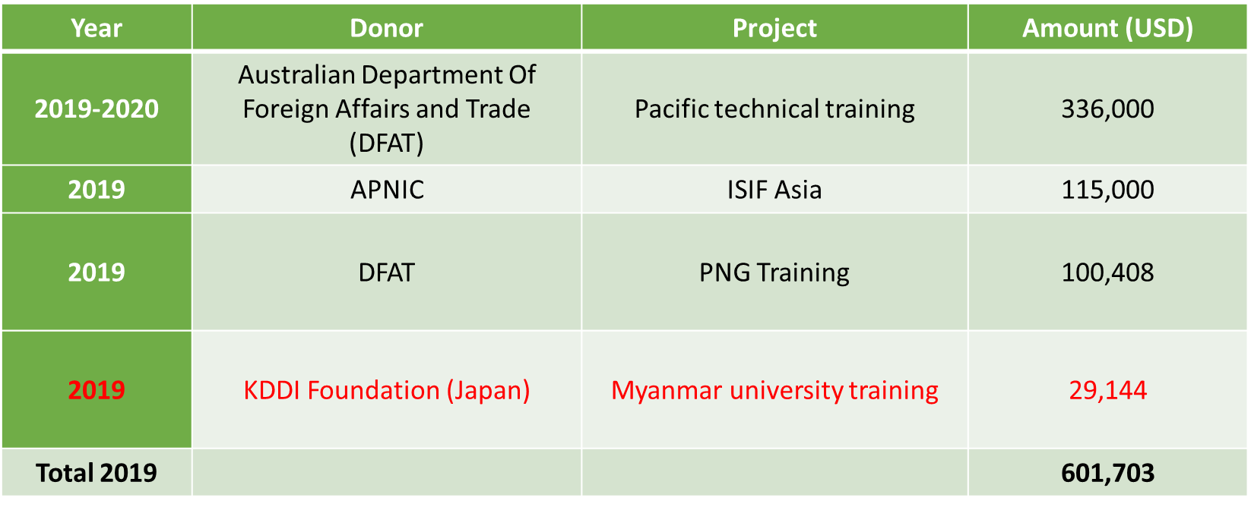
Funding to date*
* Funding in red is sent directly to APNIC

Slide 12
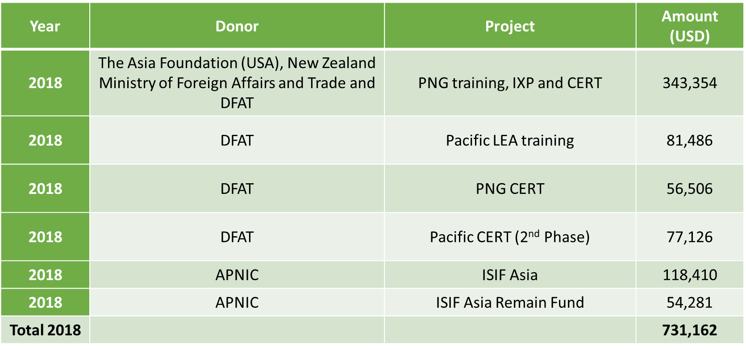
Funding to date

Slide 13
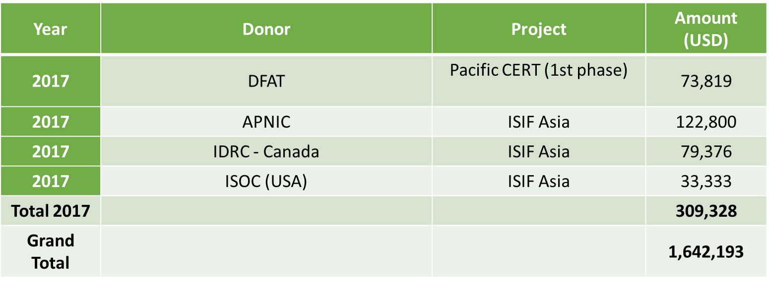
Funding to date

Slide 14
Thanks

